Slide 1
A NZ perspective

Slide 2
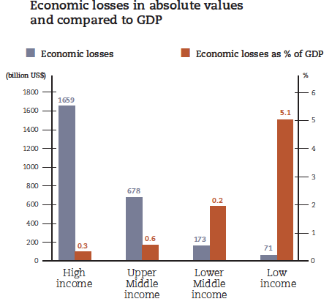
Damages
Source: GAR (2015)

Slide 3
Disaster datasets
Global
EMDAT
MunichRe & SwissRe
DesInventar
NZ
Insured (ICNZ)
NZD 36.8B (1980-2017)
?

Slide 4
Anything broken?
Where is the risk?
Exclusive reliance on insurance (risk transfer)
Social and human losses

Slide 5
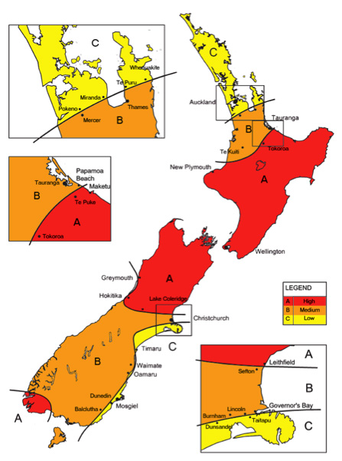
Measuring Risk The EQ uncertainty-map

Slide 6
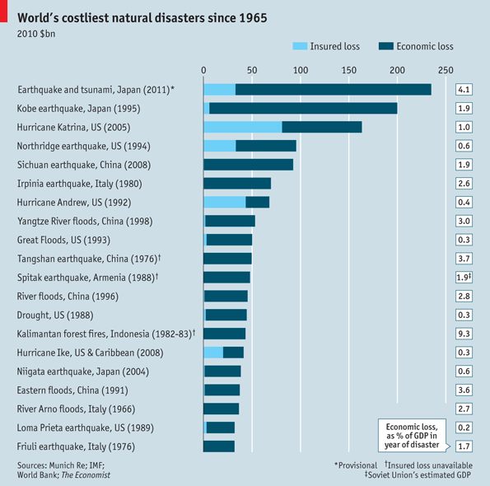

Slide 7
Insurance caveats
Insurance changes recovery by changing incentives
Some risks are currently not insurable
What about the uninsured?
Climate change will change insurance (locally)
Future change in the climate of insurance (globally)

Slide 8
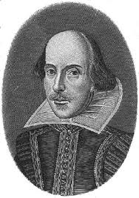
The human dimension
This is the excellent foppery of the world that when we are sick in fortune – often the surfeit of our own behaviour – we make guilty of our disasters the sun, the moon, and the stars, as if we were villains by necessity, fools by heavenly compulsion, knaves, thieves, and treachers by spherical predominance, drunkards, liars, and adulterers by an enforced obedience of planetary influence, and all that we are evil in by a divine thrusting-on”
King Lear, Act I, Scene II

Slide 9
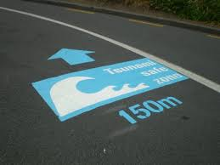
Co-benefits

